Slide 1
Enlighten your knowledge & research from Indian ethos scriptures through management vision

Slide 2
The Centre of Excellence on
"I Knowledge"
a Centre for Learning Management Tools from Indian Scriptures
[Launched by: Poddar Group of Institutions, Jaipur]

Slide 3
VISION & Mission

Slide 4
Vision & Mission
Vision:
Our vision is to integrate the profound teachings of Indian scriptures into modern management education, fostering ethical, values-driven leadership. We envision a future where managers draw inspiration from India's timeless wisdom to create sustainable, inclusive, and socially responsible business practices.
Mission:
Our mission is to research, interpret, and promote the teachings of Indian ethos scriptures, such as the Bhagavad Gita, Vedas, Upanishads, and other philosophical texts. We aim to facilitate the understanding and application of these teachings in contemporary management contexts, cultivating leaders who lead with integrity, compassion, and a holistic perspective.

Slide 5
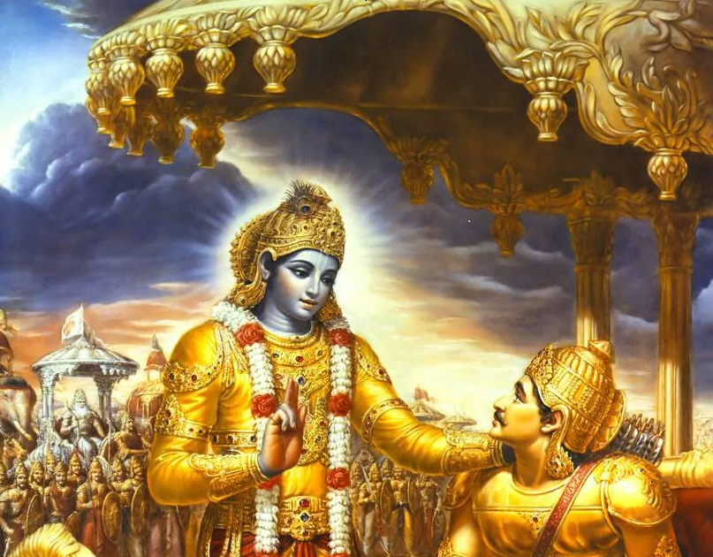
Purpose & AIM

Slide 6
Purpose
The aim of the Indian Ethos Scriptures and Management Research Lab is to explore the rich cultural and philosophical heritage of India and its relevance to modern management practices. This lab aims to bridge the gap between ancient wisdom and contemporary management by studying the insights provided by Indian scriptures and applying them to modern business contexts.

Slide 7
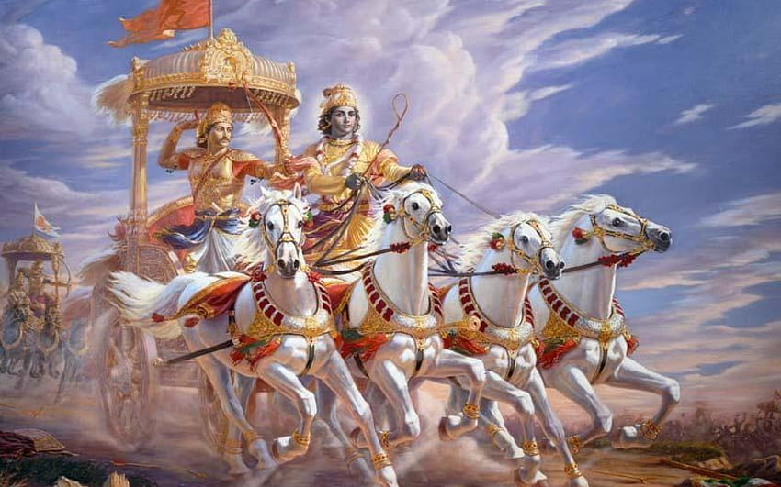
Journey & Curriculum Integration

Slide 8
Journey and Curriculum Integration
Introduction to Indian Ethos
Ethical Leadership
Spiritual Intelligence and Emotional Well-being
Sustainable Business Practices
Conflict Resolution and Team Management
Strategic Wisdom and Decision-making

Slide 9
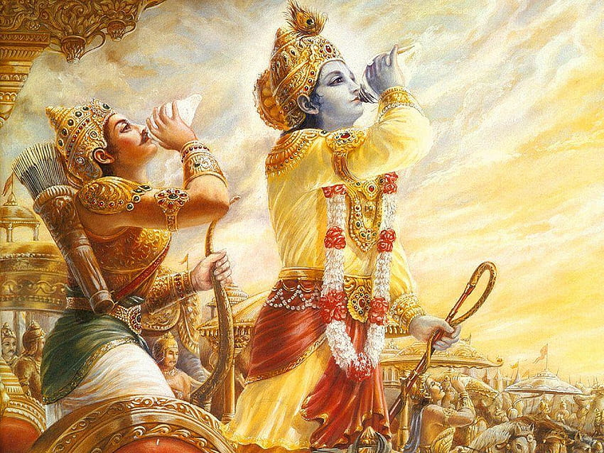

Slide 10
Lab Integration into Management Courses
The Indian Ethos Scriptures and Management Research Lab will be integrated into the Management curriculum to provide a holistic perspective. Core courses will incorporate insights from Indian scriptures, highlighting their relevance in various management disciplines. Specialized elective courses will also be offered for students interested in delving deeper into this integration.
Graduates will emerge with a profound understanding of not only modern management principles but also the timeless wisdom embedded in Indian ethos scriptures. They will be equipped to lead with a strong ethical foundation, embracing diversity, sustainability, and holistic well-being in their managerial roles

Slide 11
Thanks

